Slide 1
Longitudinal Analysis
MPHY0050 – Applied AI for Medical Imaging
02 Feb 2026 - Session 7
Tianqi Yang
tianqi.yang@ucl.ac.uk
UCL Hawkes Institute, Computer Science, University College London, UK

Slide 2
Contents
What is Longitudinal Data
Benefits of Longitudinal Data
Longitudinal Data Analysis
Recurrent Neural Networks (RNNs)
Long Short-Term Memory (LSTM)
Multi-Head Attention (Transformer)
State Space Model (Mamba)

Slide 3
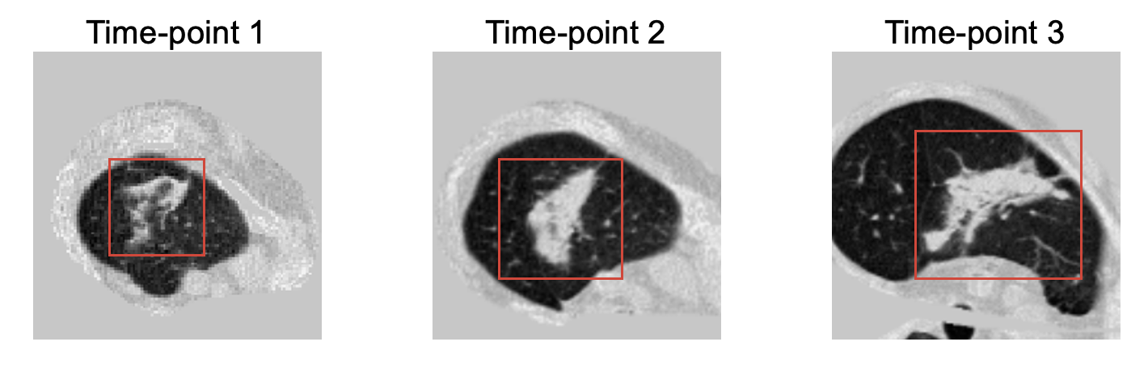
What is Longitudinal Data
A Longitudinal Data set consists of a time series for each cross-sectional member or sample in the available dataset. Longitudinal data analysis includes studying subjects over time.
For example: Longitudinal CT scans of a patient with lung cancer

Slide 4
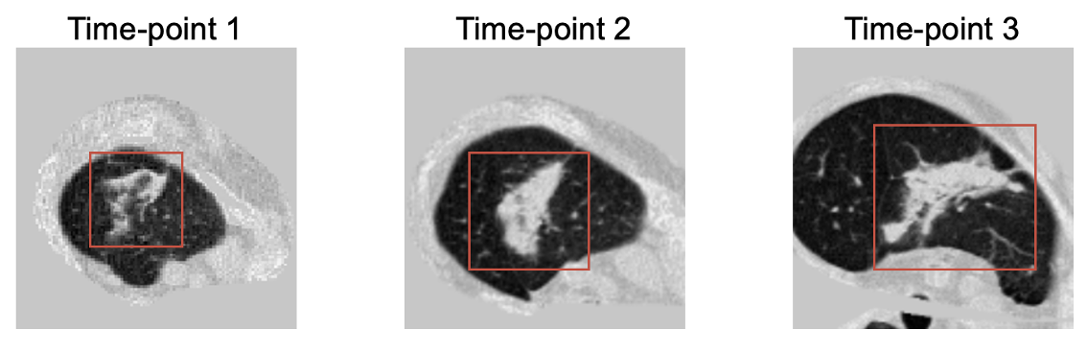
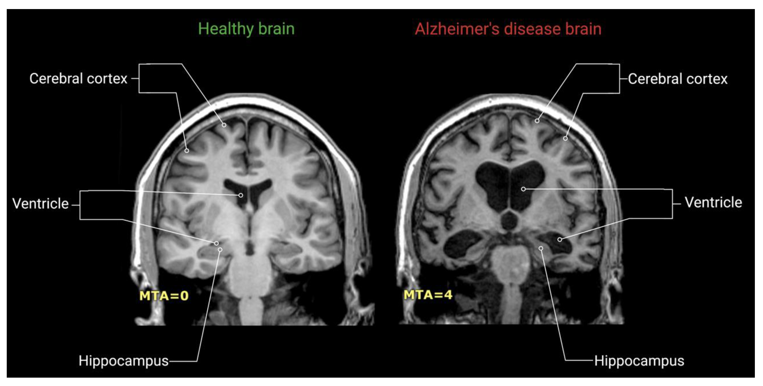
Benefits of Longitudinal Data
Captures Temporal Changes
Establishes Causality
Reduces Cohort Effects
Enhances Predictive Modeling
Provides Insights into Variability
Notes:
Longitudinal data turns static observations into dynamic stories, enabling stronger causal reasoning, better predictions, and deeper understanding of individual variability.

Slide 5
Longitudinal Data Analysis
Timeline of Sequence Learning Models
2000
2010
2015
2017
2024
RNN
LSTM
Attention
Transformer
Mamba
Recurrent Neural
Networks (RNN)
Long Short-Term Memory(RNN)
Dot-Product Attention
Multi-Head Attention
Space State Model (SSM)

Slide 6




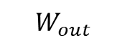
Feed-forward Neural Network
$$W_{in}$$
$$W_{out}$$
$$X$$
$$H$$
$$Y$$
Input Layer
Hidden Layer
Output Layer

Slide 7
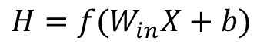
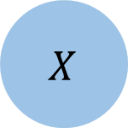
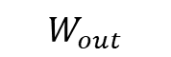

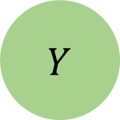

Feed-forward Neural Network
$$X$$
$$W_{in}$$
$$H$$
$$W_{out}$$
$$Y$$
$$H=f(W_{in}X+b)$$
Feed-forward Neural Network
Notes:
Image classification using CNN is fine. But for longitudinal data, we would like to know the progression.

Slide 8
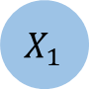
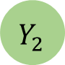

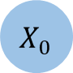
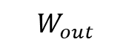
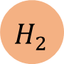

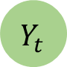



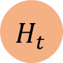
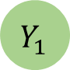

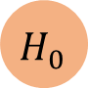
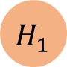
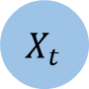
Recurrent Neural Networks (RNNs)
$$W_{in}$$
$$W_{out}$$
$${ X}_{0}$$
$${ H}_{0}$$
$${ Y}_{0}$$
$$W_{h}$$
$${ X}_{1}$$
$${ H}_{1}$$
$${ Y}_{1}$$
Time
$$W_{h}$$
$${ X}_{2}$$
$${ H}_{2}$$
$${ Y}_{2}$$
…
$$W_{h}$$
$${ X}_{t}$$
$${ H}_{t}$$
$${ Y}_{t}$$

Slide 9

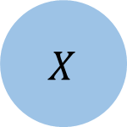
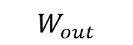

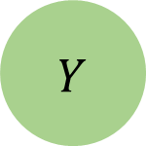

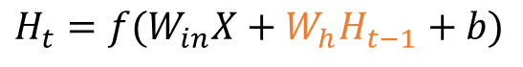
Recurrent Neural Networks (RNNs)
$$W_{h}$$
$$X$$
$$W_{in}$$
$$H$$
$$W_{out}$$
$$Y$$
$$H_{t}=f(W_{in}X+W_{h}H_{t−1}+b)$$
Memory
Recurrent Neural Network (RNN)
Notes:
Shared weights can handle flexible input sequence length

Slide 10
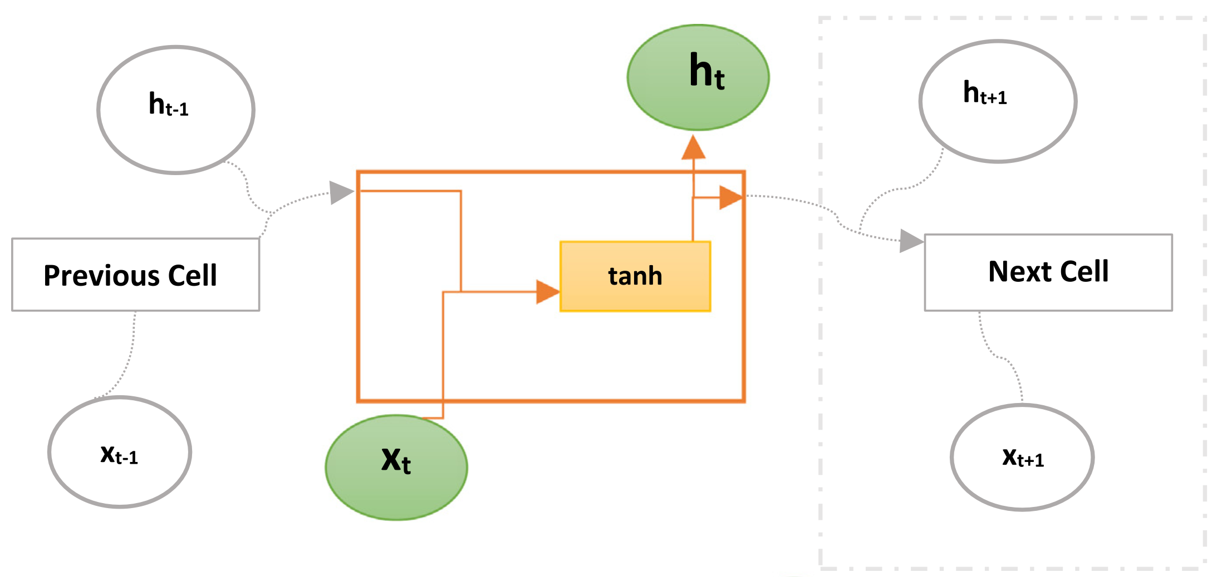
Recurrent Neural Networks (RNNs)

Slide 11
Architecture of a Traditional RNN
Output
Input
Feature Extraction
Feature (X_{t-1})
Feature (X_{t})
RNN in Two Time Points
X_{t-1}
X_{t}

Slide 12


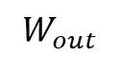
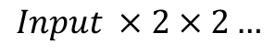
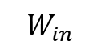





Recurrent Neural Networks (RNNs)
$$X$$
$$W_{in}$$
$$W_{out}$$
$$×2$$
$$Input ×2×2…$$
Exploding gradient
$$×2$$
…

Slide 13

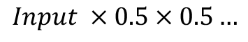

Recurrent Neural Networks (RNNs)
$$X$$
$$W_{in}$$
$$W_{out}$$
$$×0.5$$
$$Input ×0.5×0.5…$$
Vanishing gradient
$$×0.5$$
…

Slide 14
Pros and Cons of a Typical RNN
Pros:
• Model size not increasing with the size of input
• Computation takes into account historical information
• Weights are shared across time
Cons:
• Vanishing Gradient Problem
• Limited Memory Capacity
• Difficulty accessing information from a long time ago
• Sequential Processing and Limited Parallelism
Notes:
Sequential Processing and Limited Parallelism

Slide 15
Long Short-Term Memory (LSTM)
$$W_{in}$$
$$W_{out}$$
$${ X}_{0}$$
$${ H}_{0}$$
$${ Y}_{0}$$
Short-term memory
$${ X}_{1}$$
$${ H}_{1}$$
$${ Y}_{1}$$
Long-term memory
Time
$${ X}_{2}$$
$${ H}_{2}$$
$${ Y}_{2}$$
…
$${ X}_{t}$$
$${ H}_{t}$$
$${ Y}_{t}$$
Notes:
Long short-term memory uses two separate paths to make predictions.

Slide 16
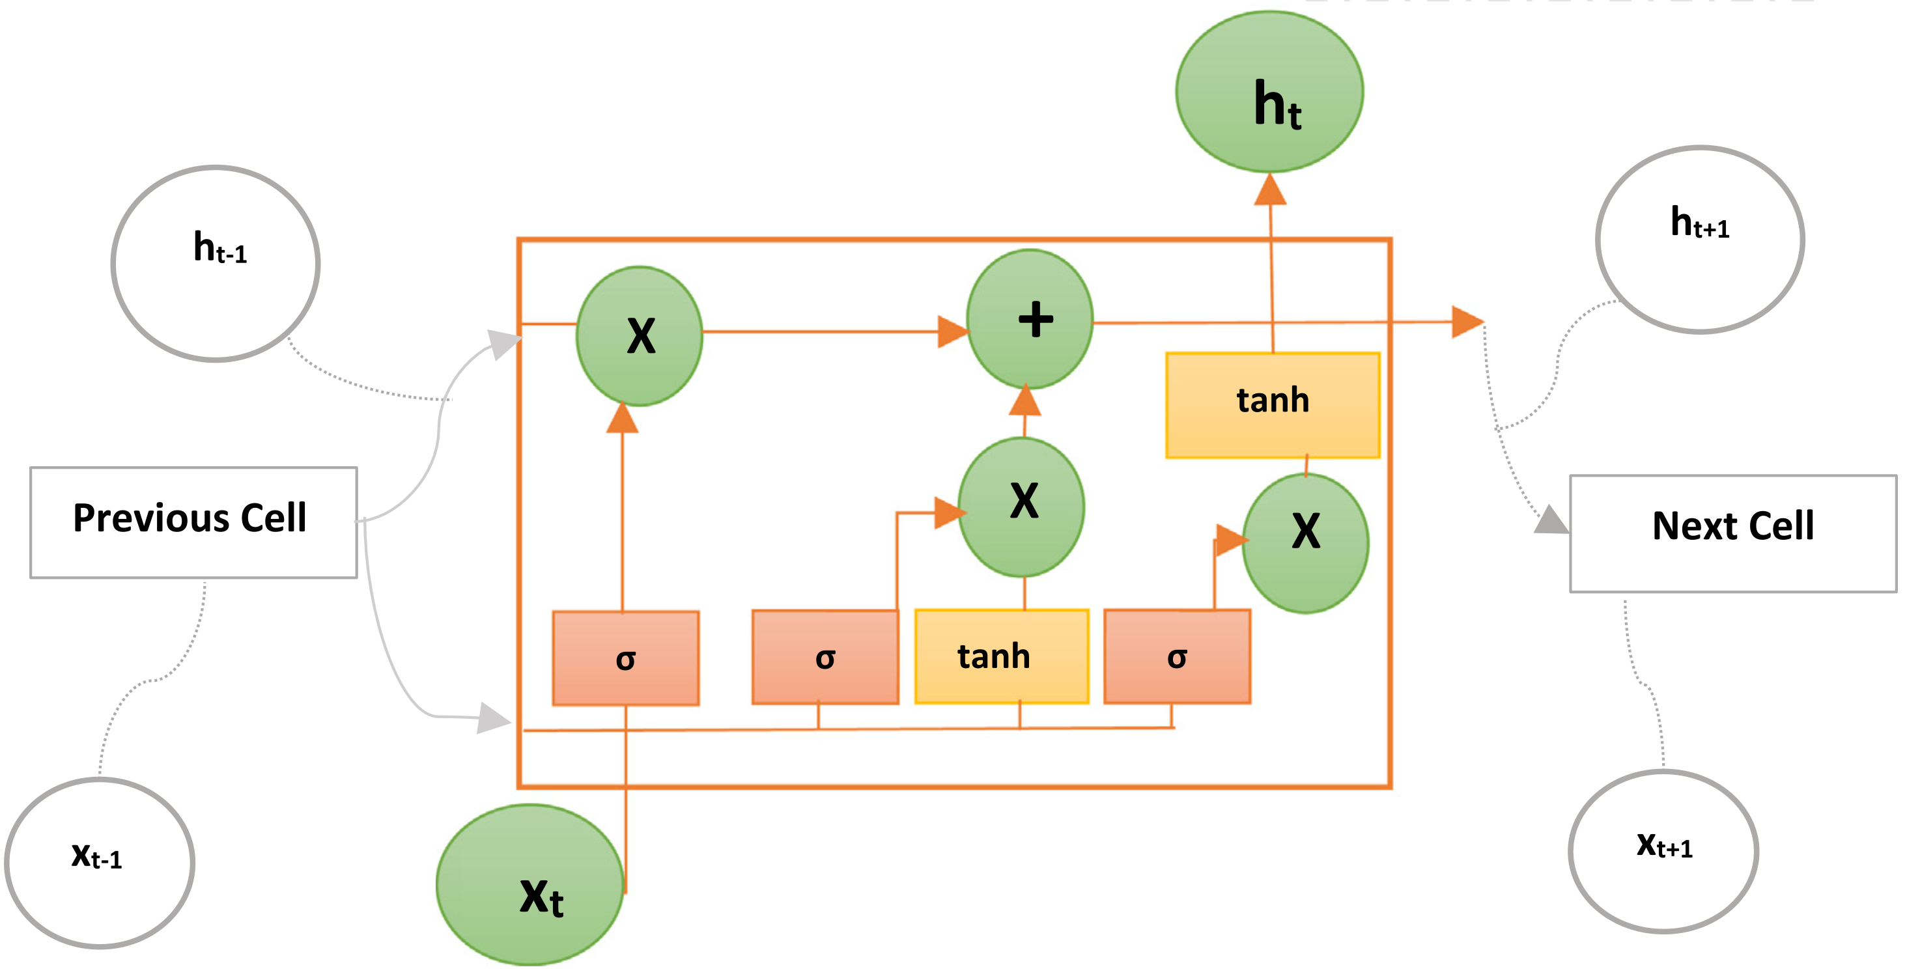
Long Short-Term Memory (LSTM)
RNN
LSTM
Notes:
Unfortunately, LSTM unrolls the RNN into a complicated structure.

Slide 17
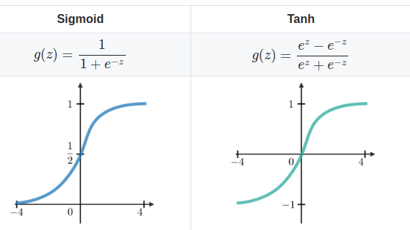
Activation Functions
([0, 1])
([-1, 1])
Notes:
Bounded ([-1, 1])Bounded ([0, 1])Unbounded ([0, ∞))
Mitigates Vanishing Gradients
Controls Exploding Activations: Since RNNs involve recurrent weight multiplication over time steps, hidden states can grow exponentially, leading to instability.
Captures Non-Linearity: The tanh function is non-linear, allowing RNNs to learn complex patterns in sequential data.

Slide 18
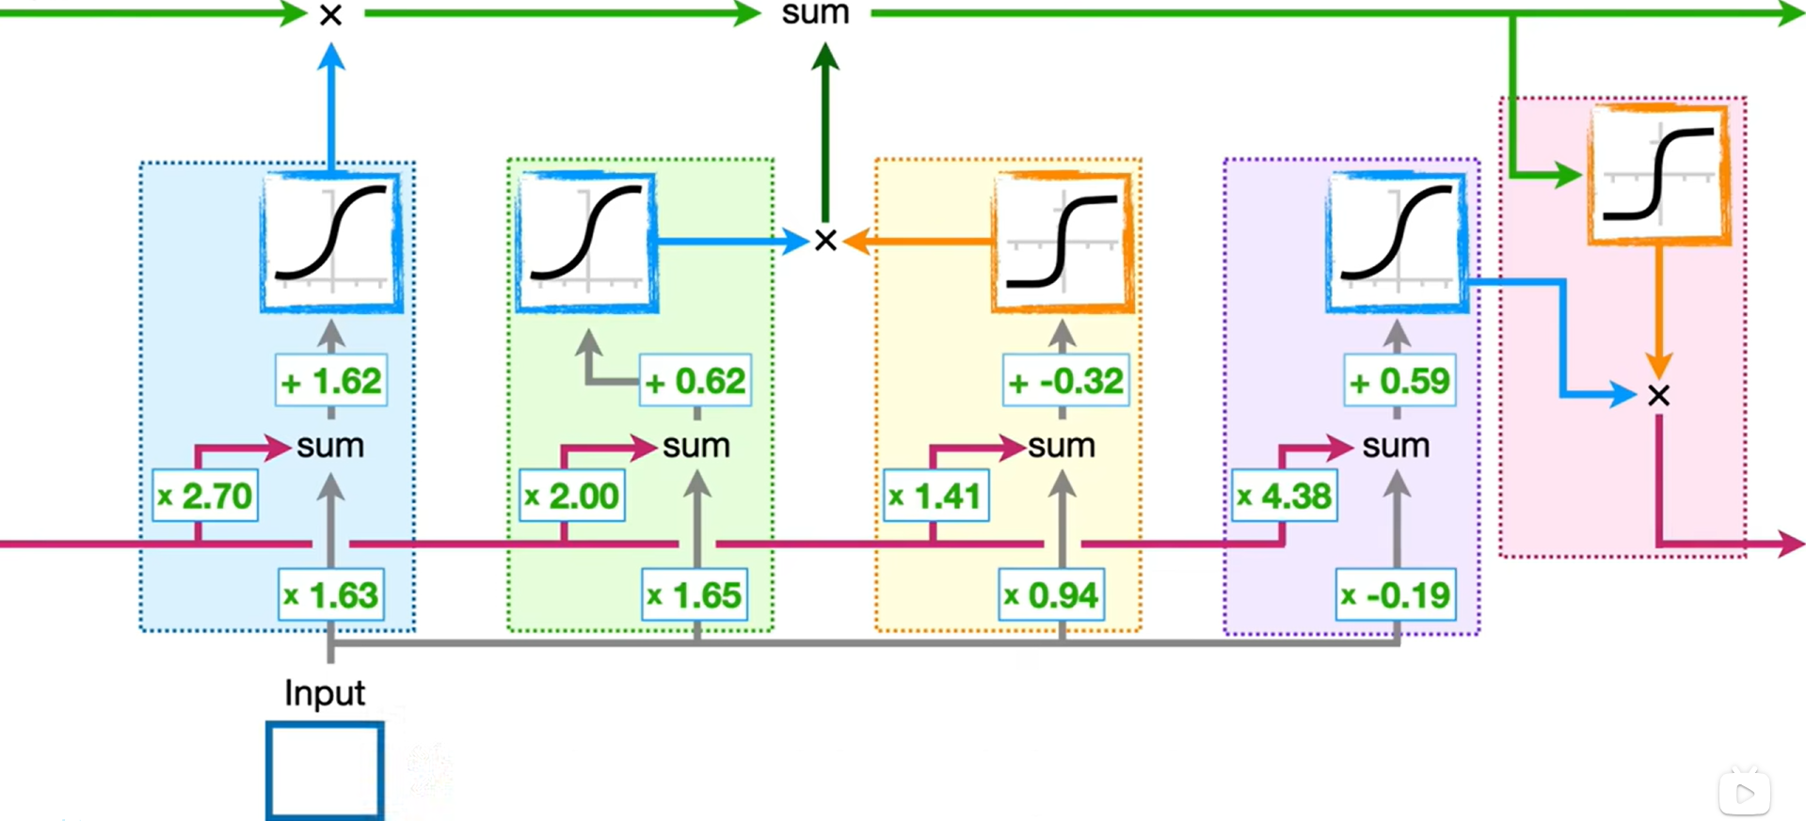
Long Short-Term Memory (LSTM)

Slide 19
Long Short-Term Memory (LSTM)
Cell State – represents the Long-Term Memory
Notes:
No weights or bias modifies long-term memory – no gradient explode or vanish.

Slide 20
Long Short-Term Memory (LSTM)
Hidden State – represents the Short-Term Memory
Notes:
Short-term memories connect to weights that can modify them.

Slide 21

Long Short-Term Memory (LSTM)
2
1
1.99
Long-Term Memory
0.997
$$\left(1×2.70\right)+\left(1×1.63\right)+1.62=5.95$$
1
Short-Term Memory
1
Notes:
Sigmoid maps x-axis coordinates to [0,1], long-term memory is slightly reduced.

Slide 22

Long Short-Term Memory (LSTM)
2
0
Long-Term Memory
0.0
% Long-Term Memory To Remember
$$0$$
Forget Gate
1
Short-Term Memory
-10
Notes:
If input is -10, long term memory from previous cell is erased. Like a ‘but’/ ‘forget it’ in a sentence.

Slide 23
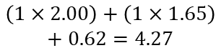
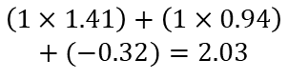



Long Short-Term Memory (LSTM)
2
1
1.99
2.96
Potential Long-Term Memory
Long-Term Memory
% Potential Memory To Remember
0.997
.97
0
1
1.0
0
.97
-1
$$\left(1×2.00\right)+\left(1×1.65\right)$$
$$+ 0.62=4.27$$
$$\left(1×1.41\right)+\left(1×0.94\right)$$
$$+ (−0.32)=2.03$$
1
1
Short-Term Memory
Input Gate
-10
1
Notes:
The block on the right combines the short term memory and the input to create a potential long term memory. The block on the left determines what percentage of that potential memory to add to the long term memory.
tanh maps x-axis coordinates to [-1,1]

Slide 24

Long Short-Term Memory (LSTM)
2
2.96
New Long-Term Memory
1.99
Potential Long-Term Memory
Long-Term Memory
% Potential Memory To Remember
% Potential Memory To Remember
0.997
.97
1
1.0
.97
.99
.99
.98
1
1
New Short-Term Memory
Short-Term Memory
Potential Short-Term Memory
1
Output Gate
Notes:
This final stage Updates Short-Term Memory
the LSTM needs to decide how much of this potential memory to pass on, Same as the method we used two time earlier, when we determine what percentage of original long term memory to remember, and when we determine what percentage of the potential long term memory to remember. In all three cases we use sigmoid activation function to determine the percentage. The new short term memory is also the output from the entire LSTM unit.

Slide 25
Long Short-Term Memory (LSTM)
2
2.96
New Long-Term Memory
1.99
Potential Long-Term Memory
Long-Term Memory
% Potential Memory To Remember
% Potential Memory To Remember
0.997
.97
1.0
.97
.99
.99
.98
1
New Short-Term Memory
Short-Term Memory
1

Slide 26
Long Short-Term Memory (LSTM)
2
2.96
New Long-Term Memory
Potential Long-Term Memory
Long-Term Memory
% Potential Memory To Remember
% Potential Memory To Remember
% Long-Term Memory To Remember
Forget Gate
1
New Short-Term Memory
Short-Term Memory
Input Gate
Output Gate
1

Slide 27
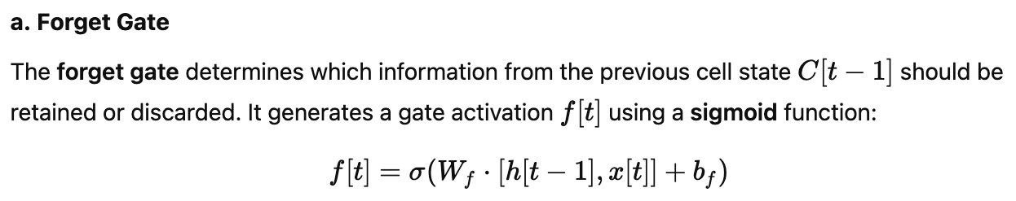
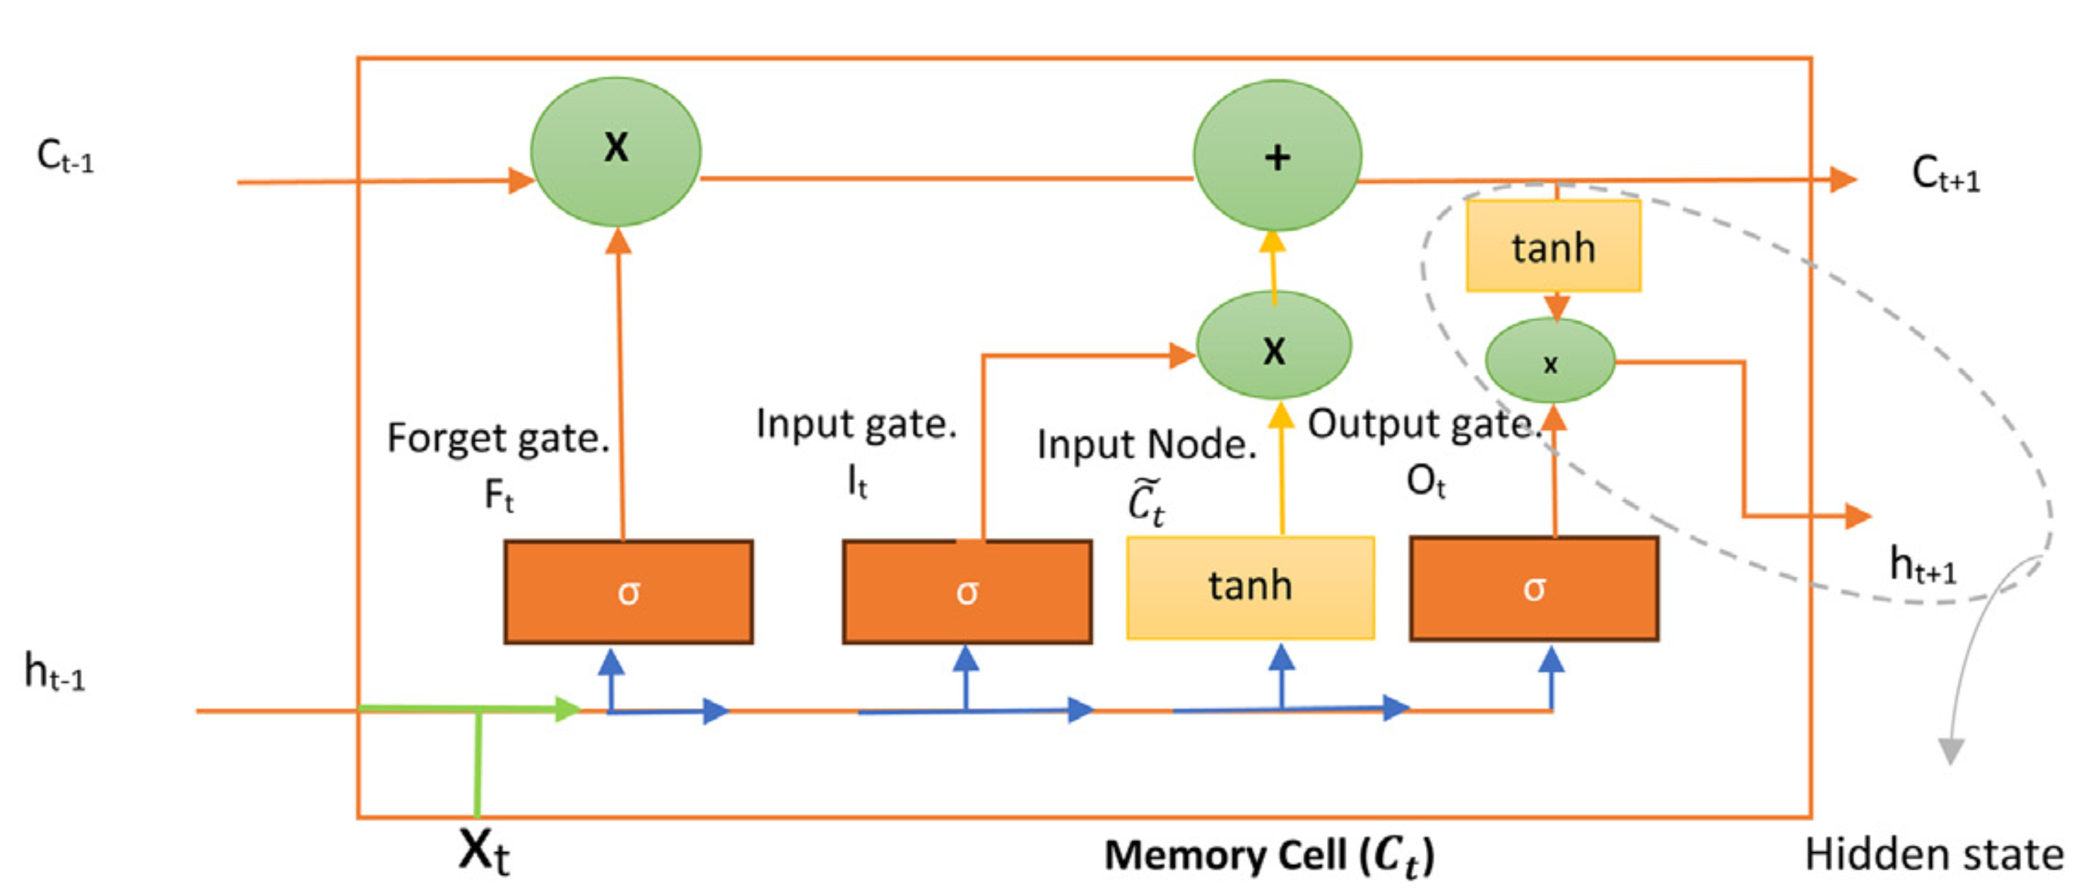
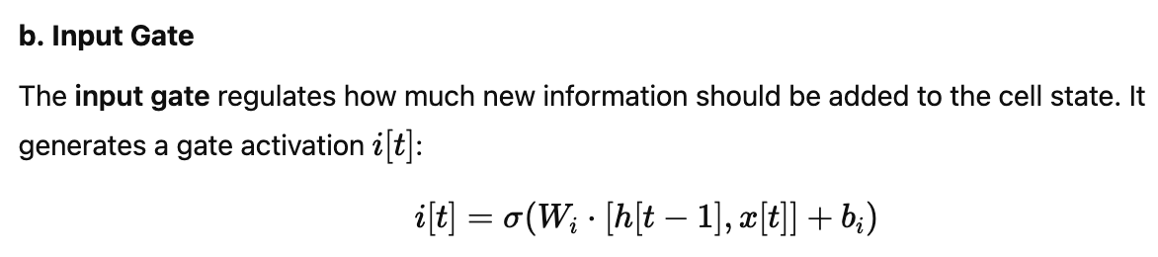
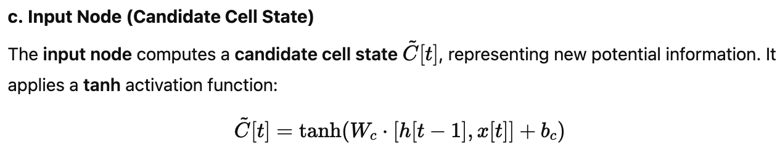
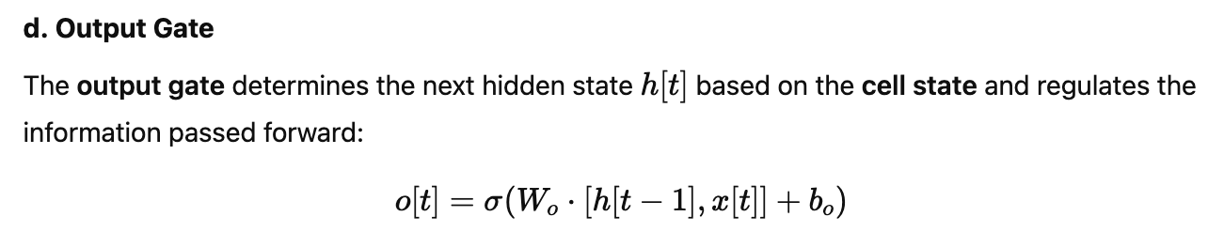
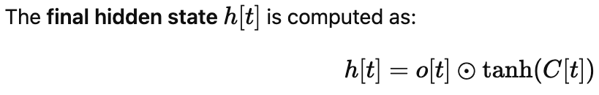
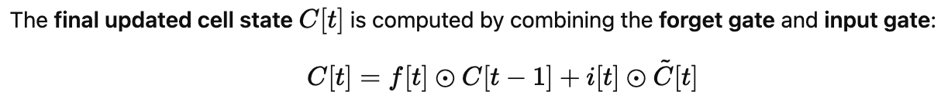
Long Short-Term Memory (LSTM)
Previous Cell State
Next Cell State
Next hidden State
Previous Hidden State

Slide 28
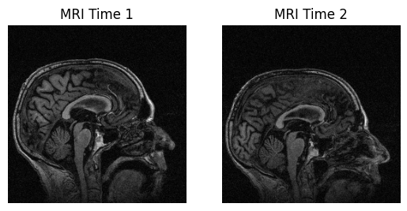
Long Short-Term Memory (LSTM)
Practical-1
Practical_1_Longitudinal_Image_ConvRNN_ConvLSTM.ipynb
Dementia Longitudinal Data

Slide 29
Different LSTM Architectures
Vanilla LSTM: has a single hidden layer of LSTM units, and an output layer used to make a prediction.
Stacked LSTM: Multiple hidden LSTM layers can be stacked one on top of another in what is referred to as a Stacked LSTM model.
Bidirectional LSTM: learn the input sequence both forward and backward and concatenate both interpretations.
CNN LSTM: A CNN model can be used in a hybrid model with an LSTM backend where the CNN is used to interpret subsequences of input that together are provided as a sequence to an LSTM model to interpret.

Slide 30
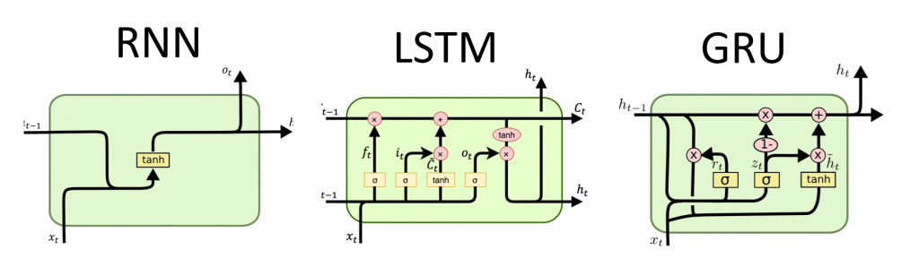
Different LSTM Architectures
Gated Recurrent Unit (GRU)
While not strictly an LSTM variant, the Gated Recurrent Unit is another type of gated recurrent network that simplifies the LSTM architecture. It combines the forget and input gates into a single update gate, making it computationally more efficient.

Slide 31
Pros and Cons of LSTMs
Pros of LSTM:
Captures Long-Term Dependencies → LSTM’s gated architecture effectively mitigates the vanishing gradient problem, enabling learning from long sequences.
Selective Memory Retention → The forget gate allows the model to retain relevant information and discard unnecessary data, improving efficiency.
Handles Sequential Data Well → LSTMs perform exceptionally in time-series tasks, speech recognition, and NLP applications due to their ability to remember past inputs.
Cons of LSTM:
Computationally Expensive → LSTMs require more parameters and memory than simpler models like vanilla RNNs or GRUs, leading to longer training times.
Prone to Overfitting → With a large number of parameters, LSTMs are susceptible to overfitting, especially on small datasets without regularization.
Difficult to Parallelize → Due to sequential dependencies in processing, LSTMs are slower compared to Transformer-based models that can leverage parallelism.

Slide 32
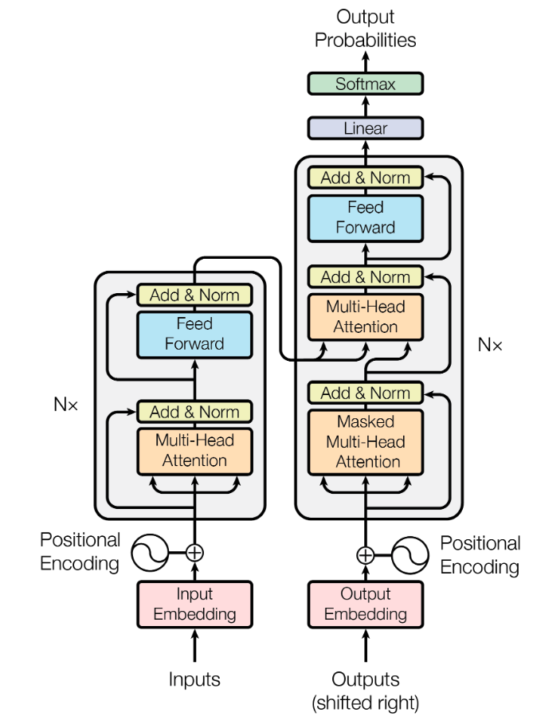
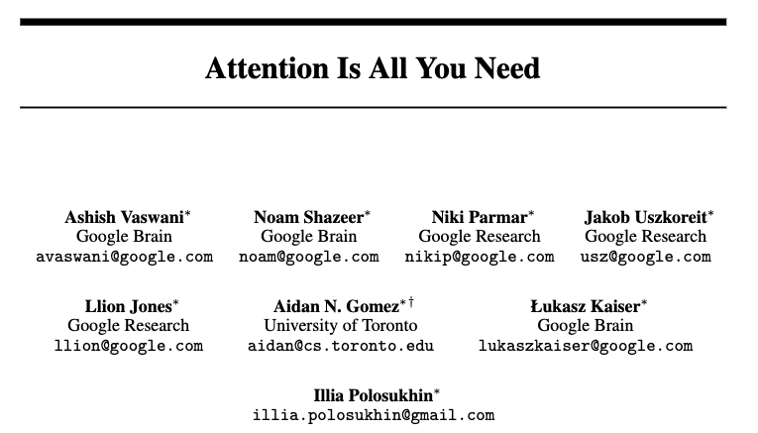

Slide 33
Sweetie, could you please help me pick up some groceries from Sainsbury’s?
Could you grab 10 eggs and three bottles of apple juice? Oh, and it’s raining outside — don’t forget your umbrella.
We also need a loaf of bread, sliced please, and a bottle of ketchup — 1000 ml. Could you also get a bag of sugar?
I think we’re running low on salt too, but it should last a few more days, so let’s leave that for now.
Oh wait — replace the apple juice with orange juice instead, and make it five bottles, 300 ml each. Also, pick up some butter.
Could you check if the yogurt is on sale?…Actually, forget it — we don’t need it anymore.
Be careful on your way back, okay? The roads can be really slippery.
Notes:
Each item in the message decides which other parts of the message matter to it – similarity/dot product

Slide 34
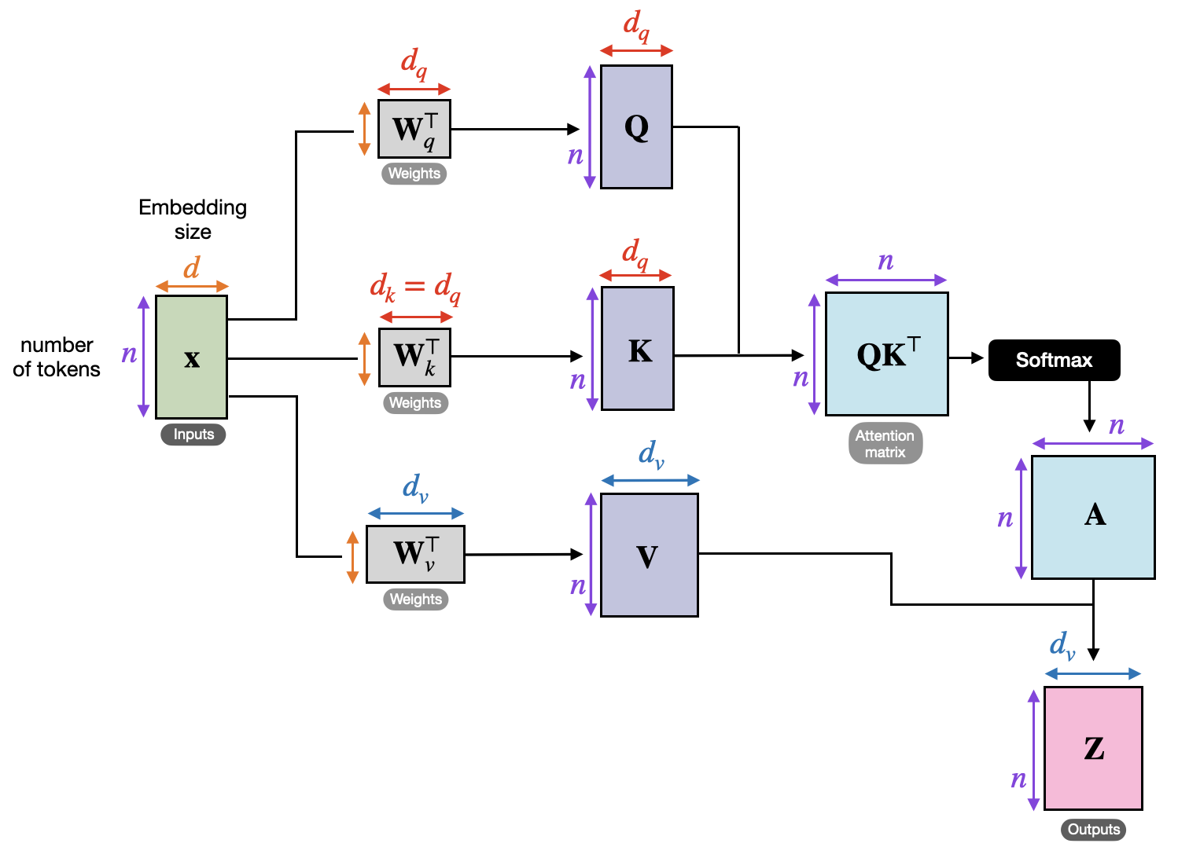
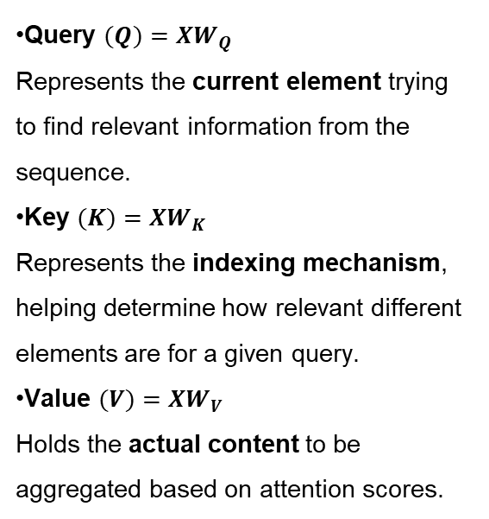
Self Attention
Query $(Q)=XW_{Q}$
Represents the current element trying to find relevant information from the sequence.
Key $(K)=XW_{K}$
Represents the indexing mechanism, helping determine how relevant different elements are for a given query.
Value $(V)=XW_{V}$
Holds the actual content to be aggregated based on attention scores.
Notes:
Each input in a sequence is transformed into three different representations using learnable weight matrices Query = what I’m looking for Key = what each thing offers Value = the information I actually take
(Example again)

Slide 35
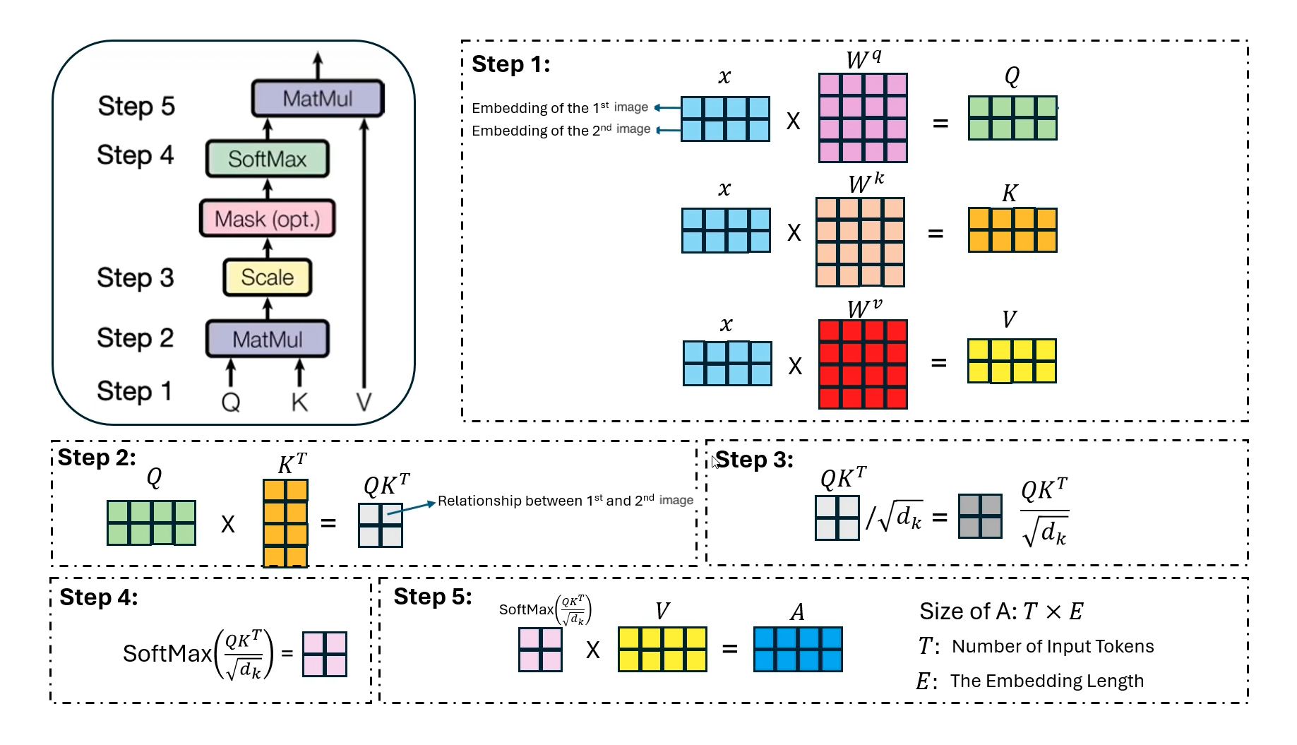
Multi-Head Attention (Transformer)
Notes:
When you read this message, you are actually doing several kinds of attention at the same time.
That’s where multi-head attention comes in.

Slide 36
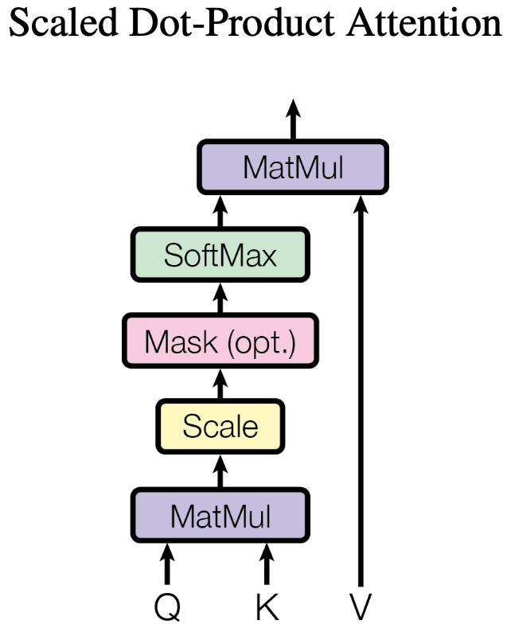
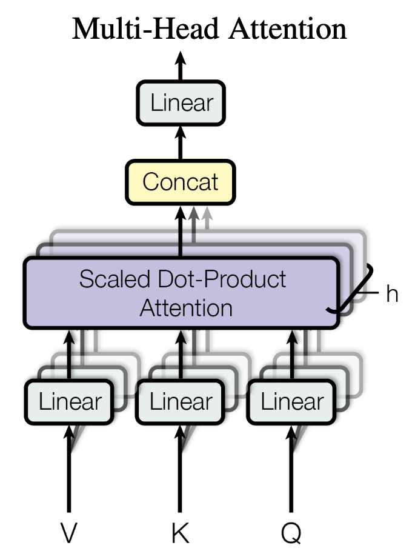
Multi-Head Attention (Transformer)

Slide 37
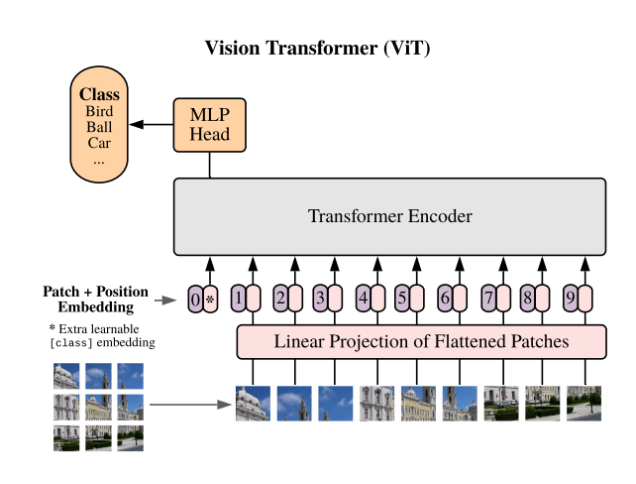

Vision Transformer (Vit)

Slide 38




Multi-Head Attention (Transformer)
Output
Input
Feature Extraction
Feature (X_{t-1})
Feature (X_{t})
X_{t-1}
X_{t}

Slide 39
Pros and Cons of Multi-Head Attention
Pros:
Captures Multi-Scale Spatial Dependencies
Long-Range Feature Learning
Parallel Computation
Cons:
Memory-Intensive
Heavy Inference Time
Harder to Interpret

Slide 40

State Space Model (SSM) [Mamba]

Slide 41






State Space Model (SSM) [Mamba]
Notes:
Linear

Slide 42




Structured State Space Model (S4) [Mamba]
Notes:
legendre polynomials

Slide 43
Parallel Scan
1
2
3
4
5
6
7
8
1
3
6
10
15
21
28
36
Notes:
Efficiency example. Simplified A=1 B=1

Slide 44
Parallel Scan
1
2
3
4
5
6
7
8
1
3
5
7
9
11
13
15
1
3
6
10
14
18
22
26
36

Slide 45








Selective State Space Model [Mamba]
$$t=1$$
$$t=2$$
$$t=3$$
Notes:
legendre polynomials

Slide 46
Pros and Cons of SSM
Pros:
Efficient Long-Range Memory → Handles long-range dependencies better than RNNs and Transformers.
Parallelizable Computation → Uses structured state-space models, enabling fast training and inference.
Stable Gradient Flow → Avoids vanishing/exploding gradients common in RNNs and Transformers.
Lower Computational Cost → Requires fewer FLOPs than self-attention in Transformers for long sequences.
Cons:
Limited Expressiveness → Lacks complex hierarchical feature extraction like Transformers.
Challenging Optimization → Requires careful tuning of structured matrices for stability.
Weaker in Complex Reasoning → May struggle with highly compositional tasks compared to attention models.

Slide 47
State Space Model (SSM) [Mamba]
Practical-2: Multi-Head Attention & SSM
Practical_2_Longitudinal_Image_ConvAttention_ConvSSM.ipynb
Dementia Longitudinal Data

Slide 48

Take Home
Recurrent Neural Network (RNN) → Captures sequential dependencies but suffers from vanishing gradients, making it ineffective for long-term memory retention.
Long Short-Term Memory (LSTM) → Solves vanishing gradients with gating mechanisms, allowing long-range dependency learning, but is computationally expensive and hard to parallelize.
Transformer → Highly parallelizable and captures long-range dependencies efficiently using self-attention, but requires quadratic complexity in memory and computation.
State-Space Model (SSM) → Efficient and stable for long-sequence modeling, leveraging parallel computation, but lacks the expressive power of deep architectures like transformers.
SSM (Recurrent)

Slide 49
Thank You!

